Slide 1
MOVING UP IN THE WORLD
1200-1450 -> 1450-1750
What’s happening?
New countries nations and empires are coming up both on land and maritime
This demarcation is where they get most of their wealth
The early modern period was a time of significant change and upheaval as land-based empires rose to prominence, consolidated their power, and implemented diverse methods to legitimize their rule. Competition between these empires, internal conflicts, and the eventual rise of maritime empires would reshape the political landscape of the world in the centuries to come.

Slide 2
Look up a map of the United States of America

Slide 3
What about the territories?
Who does the United States own and have follow the Constitution?
Puerto Rico, Guam, U.S. Virgin Islands, American Samoa, Northern Mariana Islands, Wake Island, Midway Atoll, Johnston Atoll
Why did we not include these?
What is an empire?

Slide 4
Empire definition
Do we have empires anymore?
Where did they go?
What has replaced empires? The actual government or just a label?
Empire or nation or superpower or dynasty??
Sort the following into nation, superpower, or empire

Slide 5
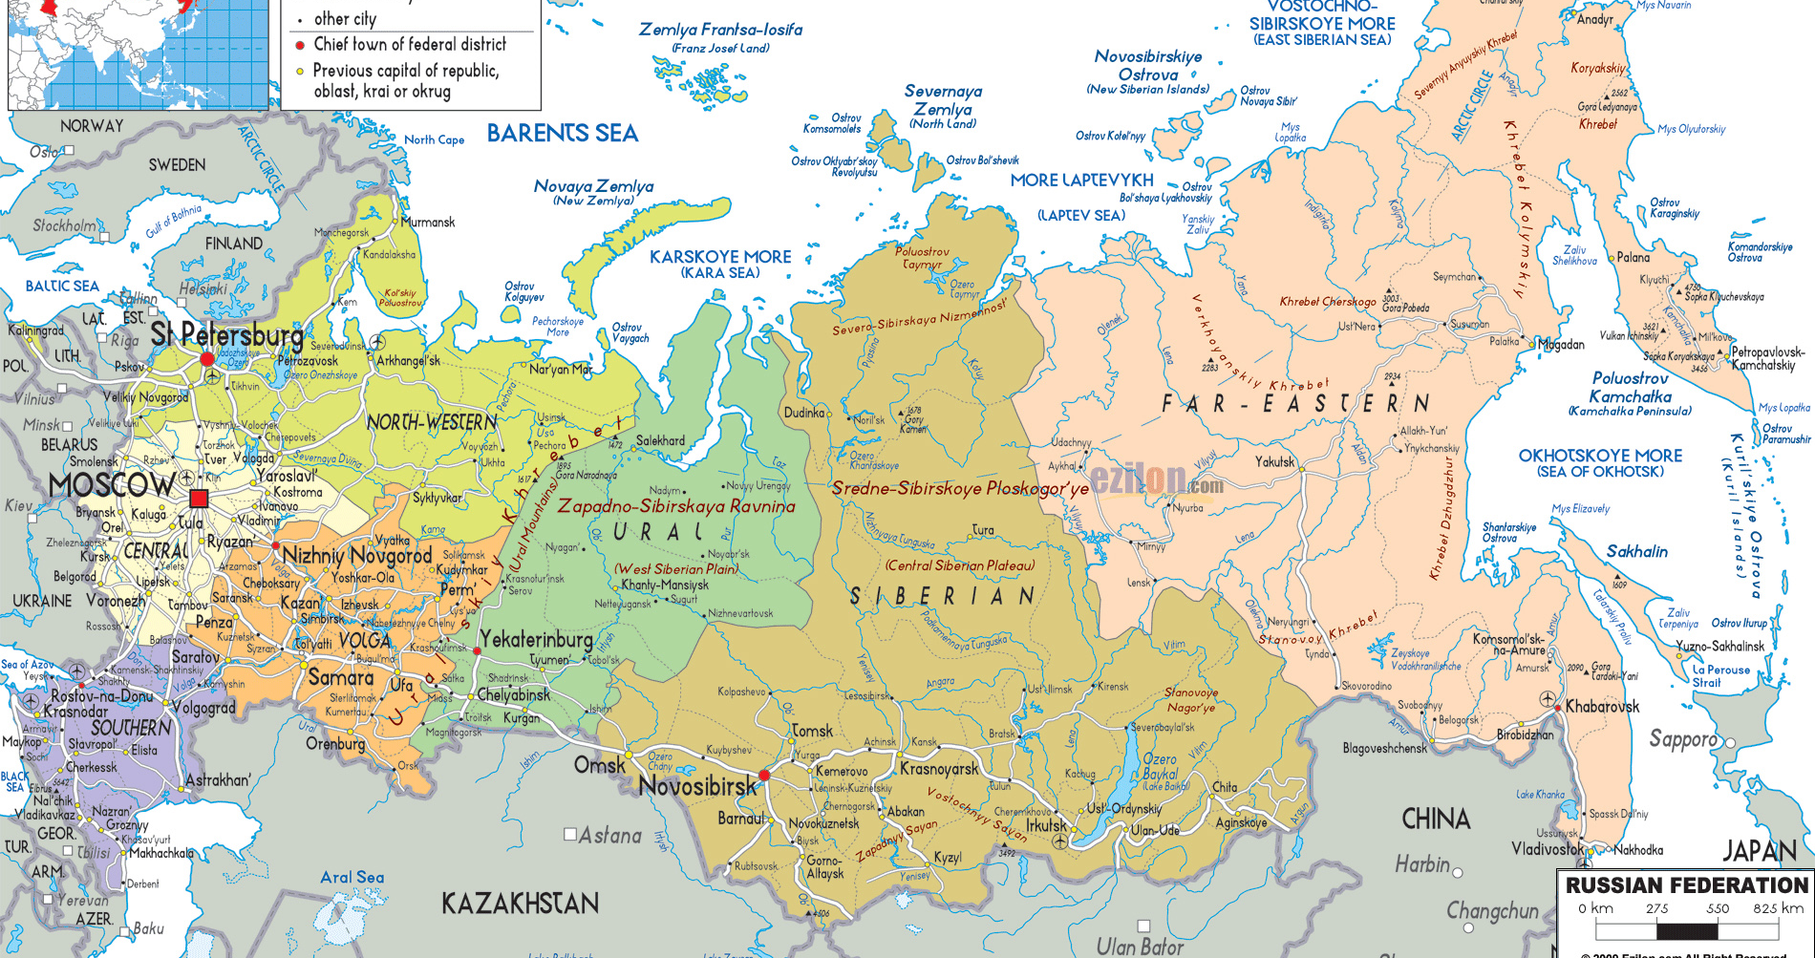

Slide 6
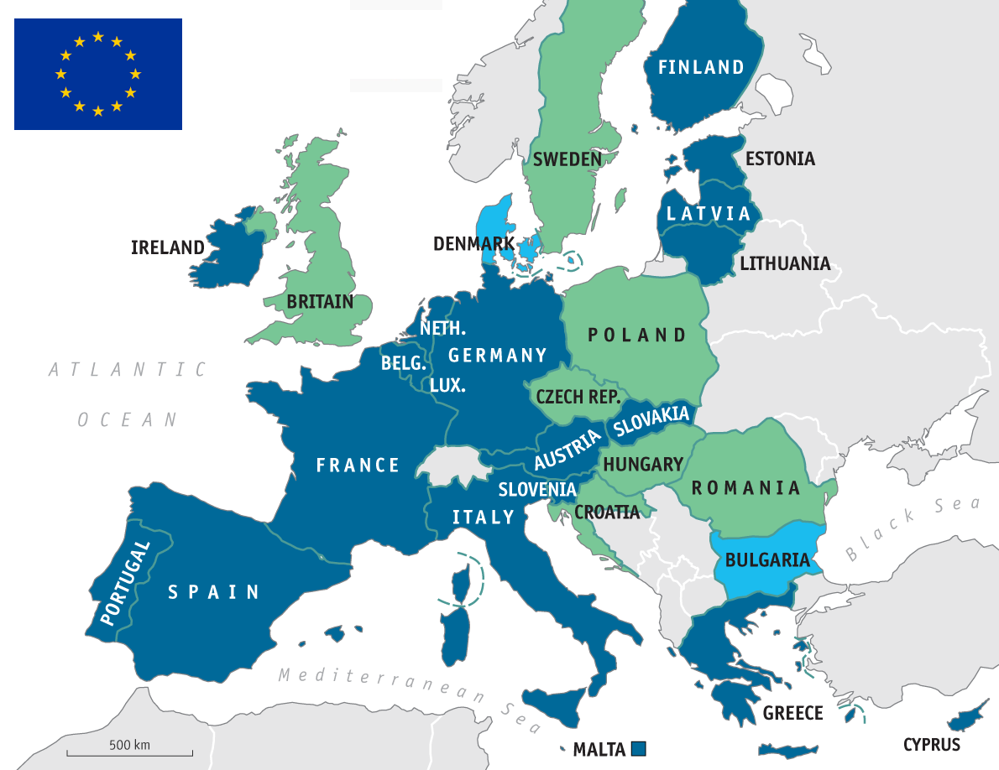

Slide 7
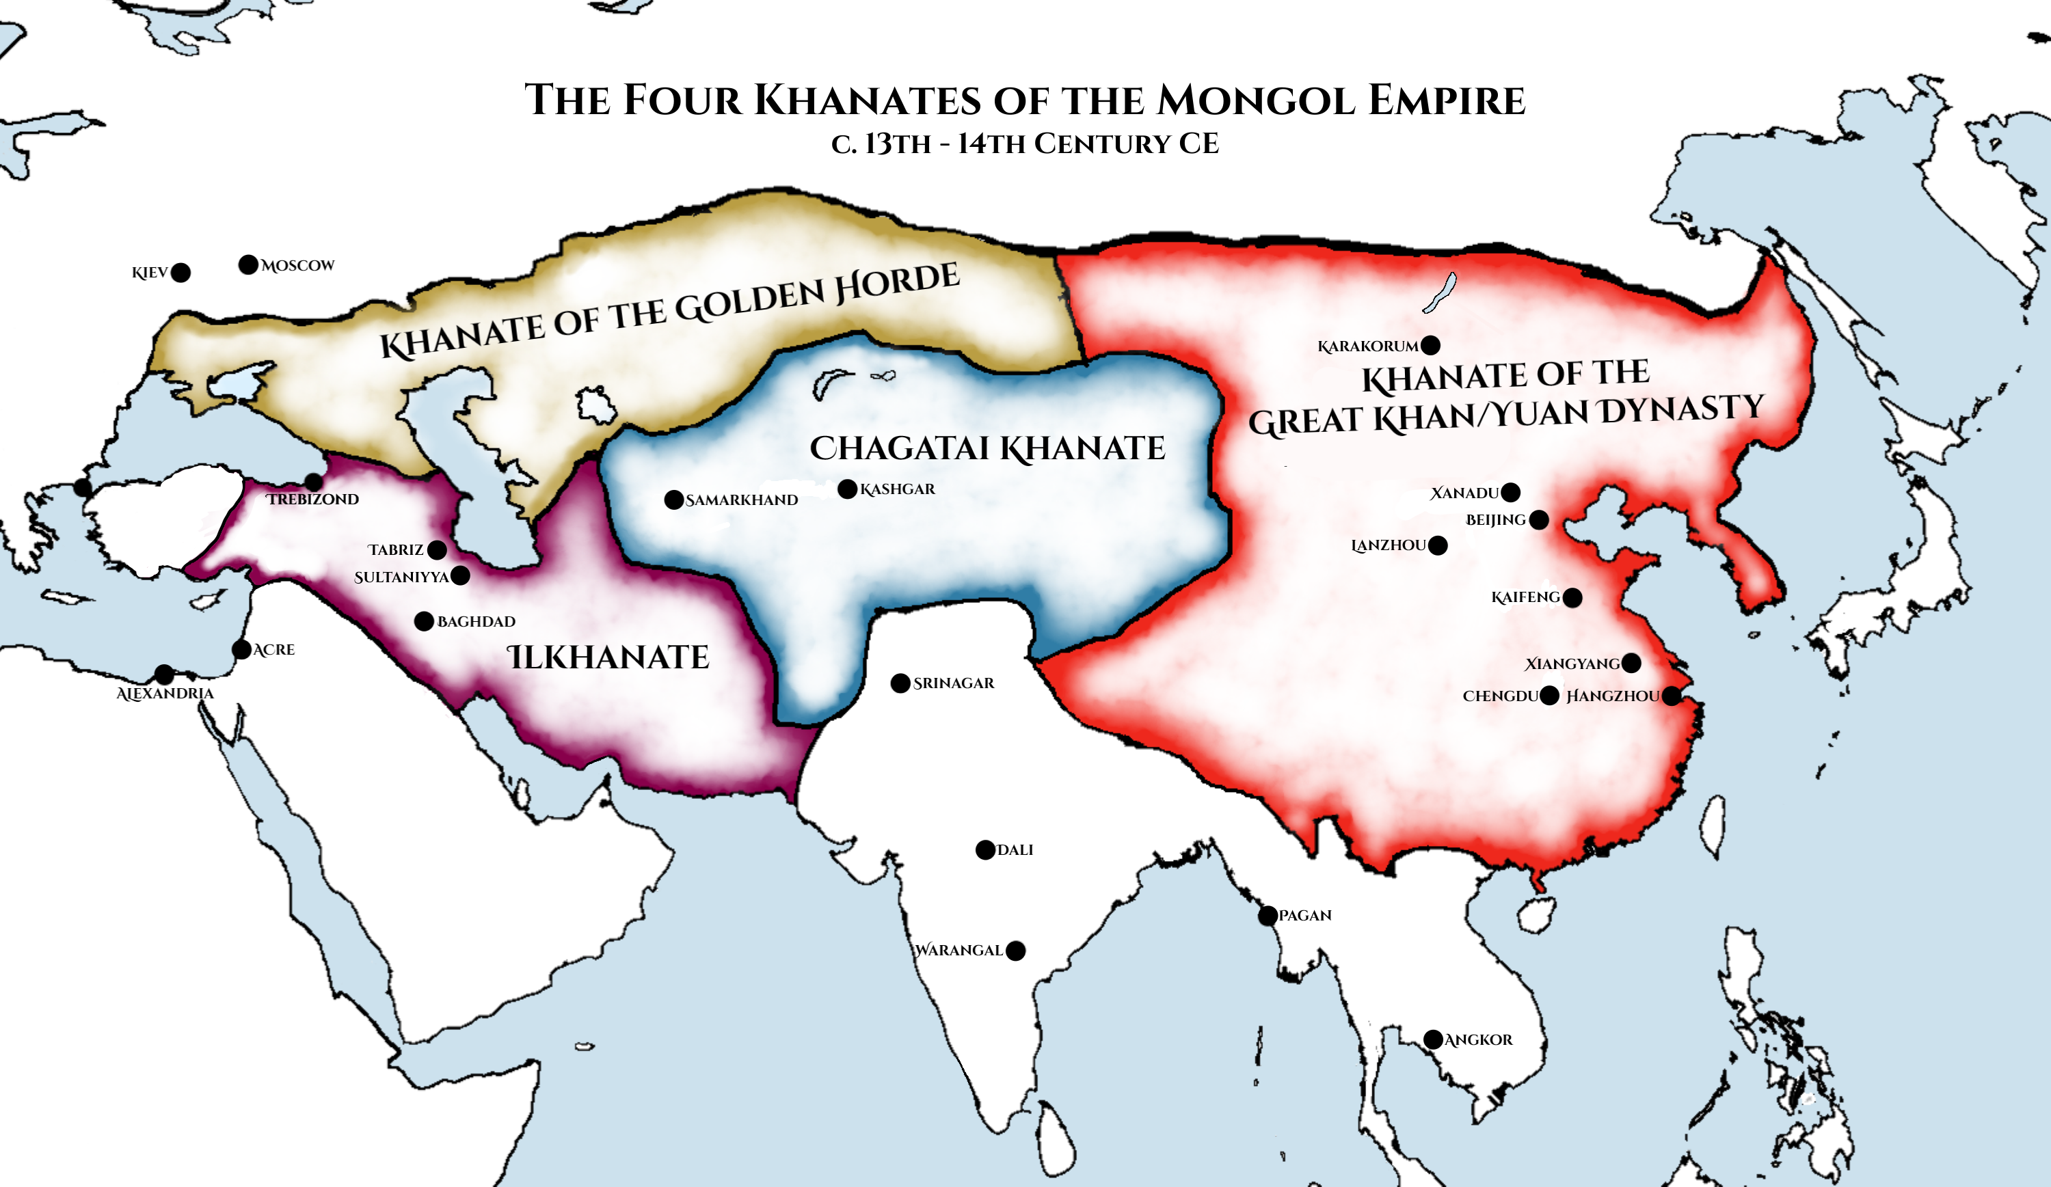

Slide 8
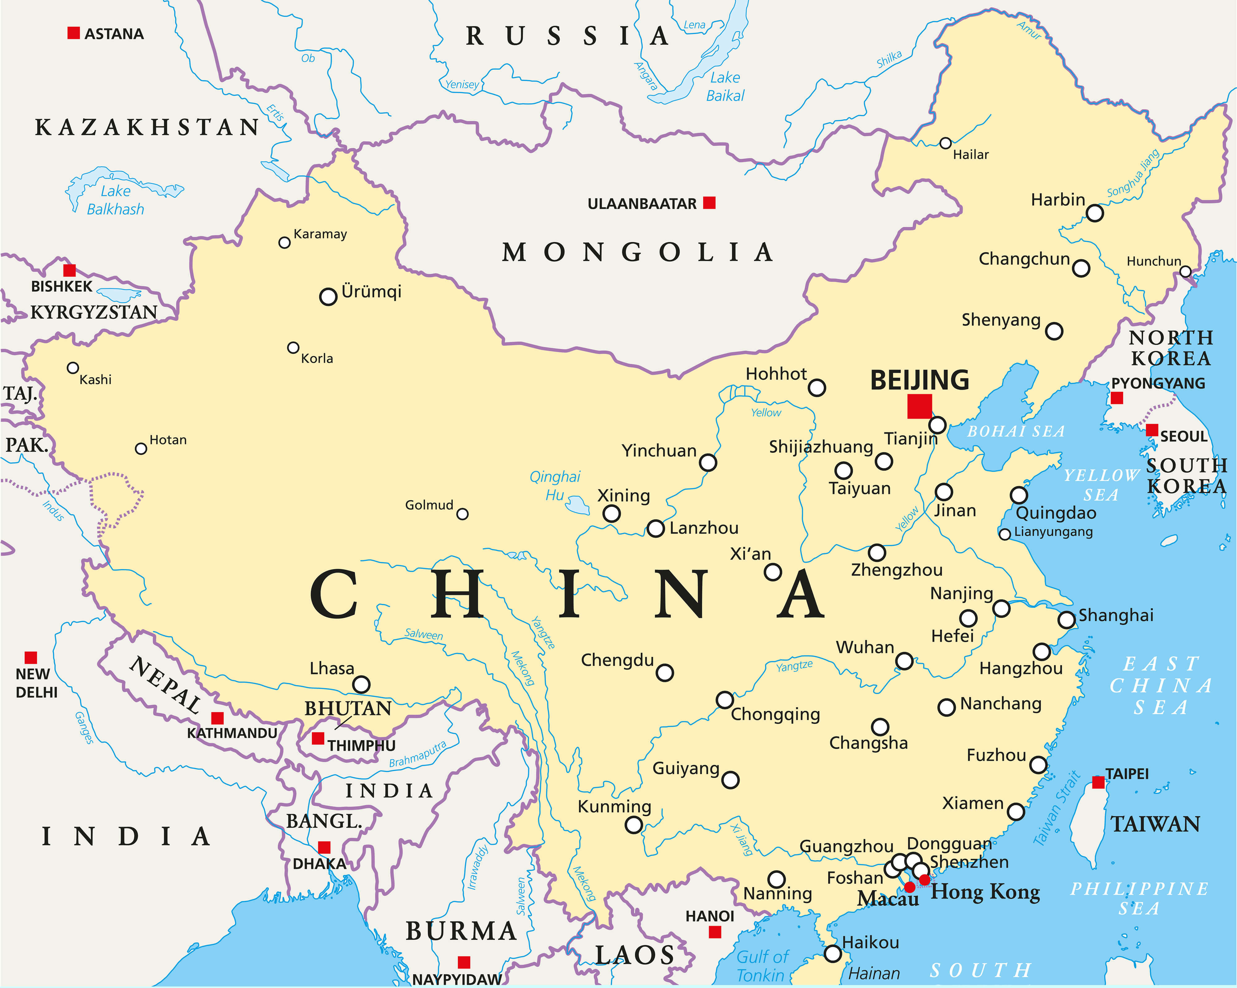

Slide 9
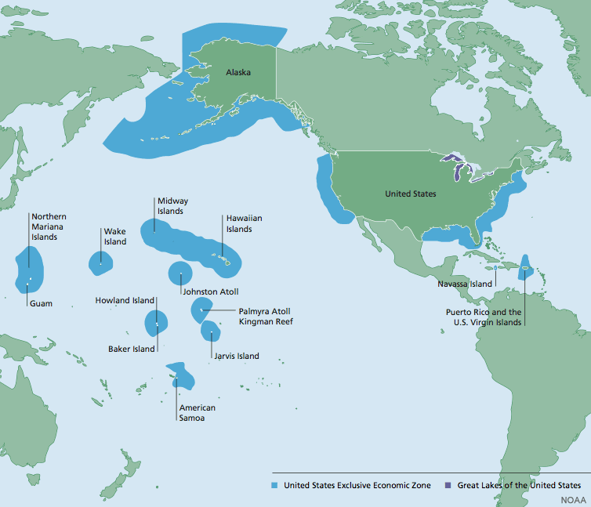

Slide 10
Empires and land how connected?
how does someone get land?
What is the most just way to do that?
Who do we need to consider?
What is the most just way to expand your empire?
KILL EVERYONE?
INCORPORATE EVERYONE?
DECIDE? ONLY EXPAND WHERE THEY WANT YOU? GO WHERE NO PEOPLE ARE?

Slide 11
Investigate an Empire
Make a presentation with your group on your empire highlighting the following
Why are they an empire
Land and expansion they went through
Policies on how they expanded, who did they move or incorporate?
Challenges
Culture of the empire in expanded territory
Outline on YOUR map how your empire started and expanded

